Slide 1
Feedback Control Systems (FCS)
Lecture-14-15
Block Diagram Representation of Control Systems
Dr. Imtiaz Hussain
email: imtiaz.hussain@faculty.muet.edu.pk
URL :http://imtiazhussainkalwar.weebly.com/

Slide 2
Introduction
A Block Diagram is a shorthand pictorial representation of the cause-and-effect relationship of a system.
The interior of the rectangle representing the block usually contains a description of or the name of the element, or the symbol for the mathematical operation to be performed on the input to yield the output.
The arrows represent the direction of information or signal flow.

Slide 3
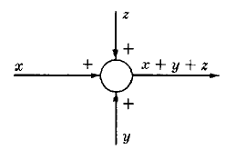
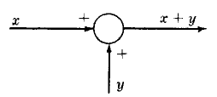
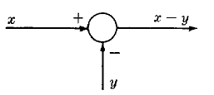
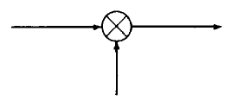
Introduction
The operations of addition and subtraction have a special representation.
The block becomes a small circle, called a summing point, with the appropriate plus or minus sign associated with the arrows entering the circle.
The output is the algebraic sum of the inputs.
Any number of inputs may enter a summing point.
Some books put a cross in the circle.

Slide 4
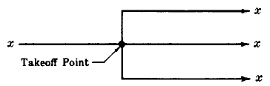
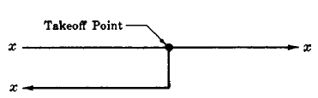
Introduction
In order to have the same signal or variable be an input to more than one block or summing point, a takeoff point is used.
This permits the signal to proceed unaltered along several different paths to several destinations.

Slide 5
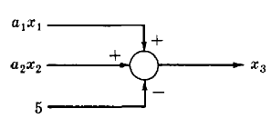

Example-1
Consider the following equations in which x₁, x₂, x₃, are variables, and a₁, a₂ are general coefficients or mathematical operators.

Slide 6
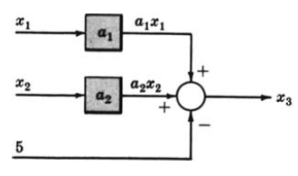
Example-1
Consider the following equations in which x₁, x₂, x₃, are variables, and a₁, a₂ are general coefficients or mathematical operators.

Slide 7
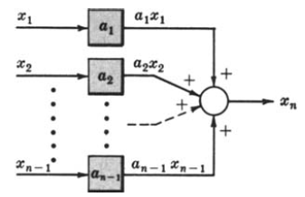
Example-2
Consider the following equations in which x₁, x₂,. . . , x_{n}, are variables, and a₁, a₂,. . . , a_{n} , are general coefficients or mathematical operators.

Slide 8
Example-3
Draw the Block Diagrams of the following equations.

Slide 9
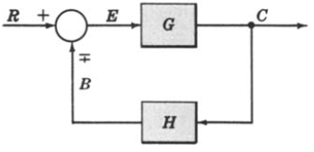
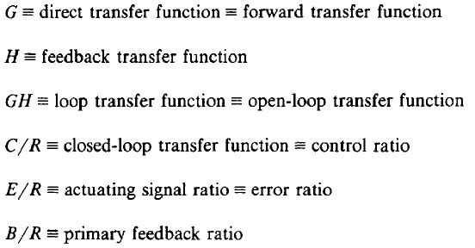



Canonical Form of A Feedback Control System

Slide 10
Characteristic Equation
The control ratio is the closed loop transfer function of the system.
The denominator of closed loop transfer function determines the characteristic equation of the system.
Which is usually determined as:

Slide 11
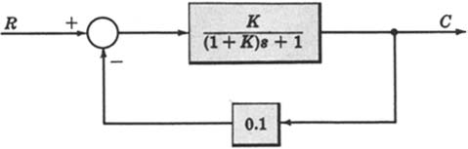
Example-4
Open loop transfer function
Feed Forward Transfer function
control ratio
feedback ratio
error ratio
closed loop transfer function
characteristic equation
closed loop poles and zeros if K=10.

Slide 12
Reduction techniques
1. Combining blocks in cascade
2. Combining blocks in parallel

Slide 13
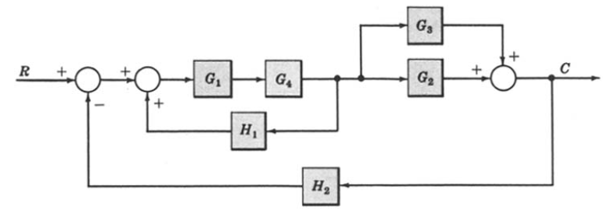
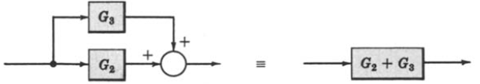
Example-5: Reduce the Block Diagram to Canonical Form.

Slide 14
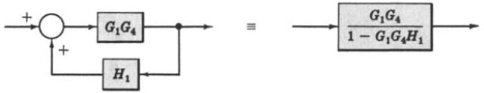
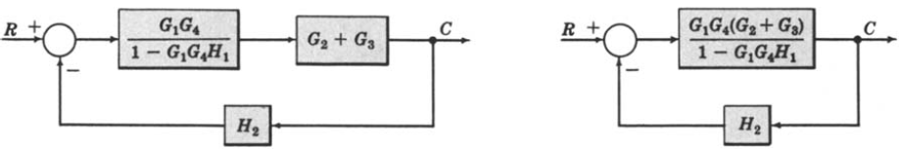
Example-5: Continue.
However in this example step-4 does not apply.
However in this example step-6 does not apply.

Slide 15
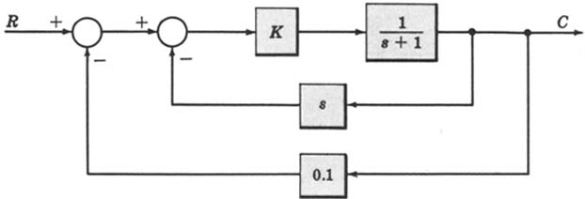
Example-6
For the system represented by the following block diagram determine:
Open loop transfer function
Feed Forward Transfer function
control ratio
feedback ratio
error ratio
closed loop transfer function
characteristic equation
closed loop poles and zeros if K=10.

Slide 16
Example-6
First we will reduce the given block diagram to canonical form

Slide 17
Example-6

Slide 18
Example-6
Open loop transfer function
Feed Forward Transfer function
control ratio
feedback ratio
error ratio
closed loop transfer function
characteristic equation
closed loop poles and zeros if K=10.

Slide 19
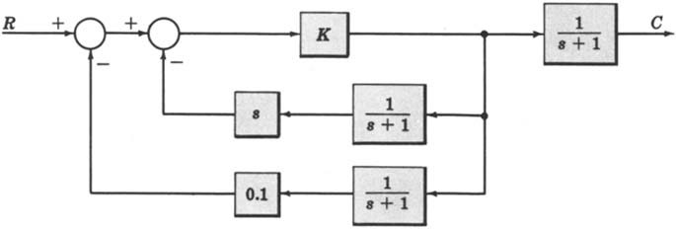
Example-7
For the system represented by the following block diagram determine:
Open loop transfer function
Feed Forward Transfer function
control ratio
feedback ratio
error ratio
closed loop transfer function
characteristic equation
closed loop poles and zeros if K=100.

Slide 20
Reduction techniques
3. Moving a summing point behind a block

Slide 21
3. Moving a summing point ahead of a block
4. Moving a pickoff point behind a block
5. Moving a pickoff point ahead of a block

Slide 22
6. Eliminating a feedback loop
7. Swap with two neighboring summing points

Slide 23
Example-8
_
+
_
+
+
+

Slide 24
Example-8
_
+
+
+
_
+

Slide 25
Example-8
_
+
+
+
_
+

Slide 26
Example-8
_
+
_
+
+
+

Slide 27
block diagram: reduction example
_
+
_
+

Slide 28
block diagram: reduction example
_
+
_
+

Slide 29
block diagram: reduction example
+
_

Slide 30
Example-8

Slide 31
Example 9
Find the transfer function of the following block diagrams
R
(
s
)

Slide 32
Solution:
1. Moving pickoff point A ahead of block
2. Eliminate loop I & simplify

Slide 33
3. Moving pickoff point B behind block

Slide 34
4. Eliminate loop III
Using rule 6

Slide 35
Example 10
Find the transfer function of the following block diagrams

Slide 36
Solution:
1. Eliminate loop I
2. Moving pickoff point A behind block
Not a feedback loop

Slide 37
3. Eliminate loop II
Using rule 6

Slide 38
Example 11
Find the transfer function of the following block diagrams

Slide 39
Solution:
1. Moving pickoff point A behind block

Slide 40
2. Eliminate loop I and Simplify
feedback
Not feedback

Slide 41
3. Eliminate loop II & IIII
Using rule 6

Slide 42
Example 12
Find the transfer function of the following block diagrams

Slide 43
Solution:
1. Moving pickoff point A behind block

Slide 44
2. Eliminate loop I & Simplify

Slide 45
3. Eliminate loop II

Slide 46
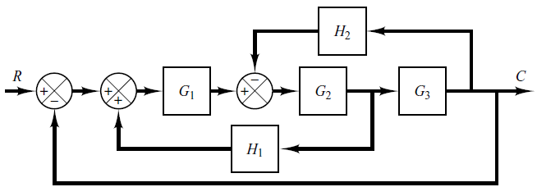
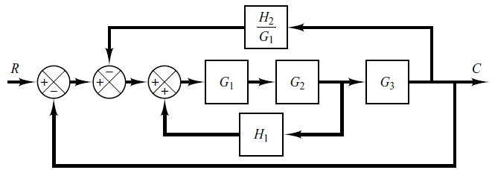
Example-13: Simplify the Block Diagram.

Slide 47
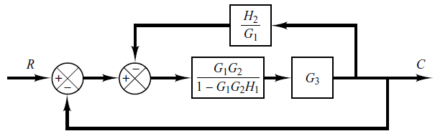
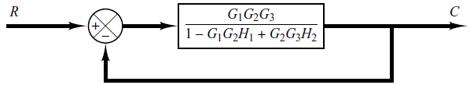

Example-13: Continue.

Slide 48
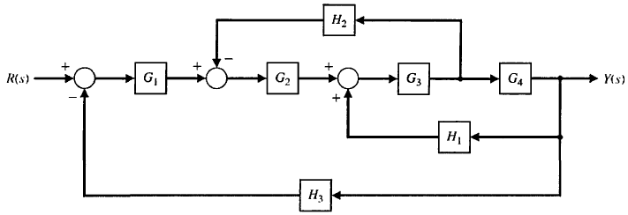
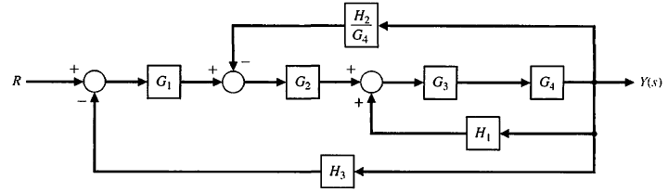
Example-14: Reduce the Block Diagram.

Slide 49
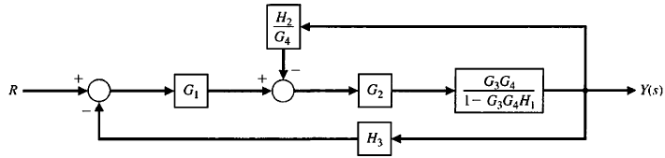
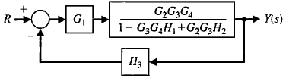

Example-14: Continue.

Slide 50
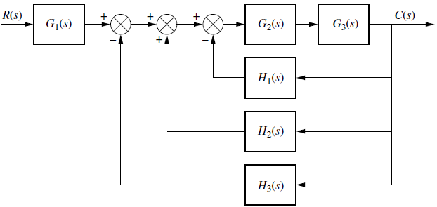
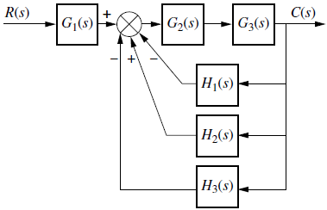
Example-15: Reduce the Block Diagram. (from Nise: page-242)

Slide 51
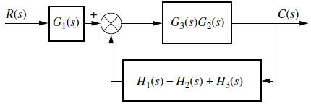

Example-15: Continue.

Slide 52
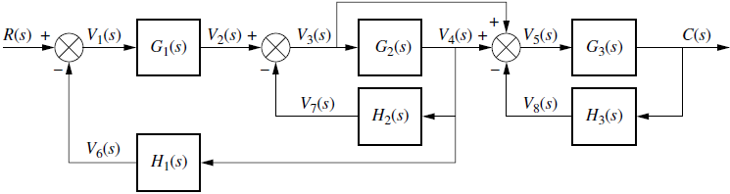
Example-16: Reduce the system to a single transfer function. (from Nise:page-243).

Slide 53
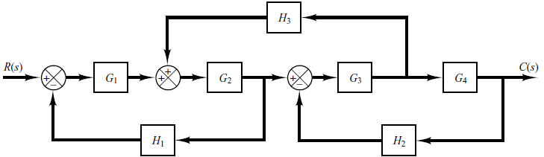
Example-17: Simplify the block diagram then obtain the close-loop transfer function C(S)/R(S). (from Ogata: Page-47)

Slide 54
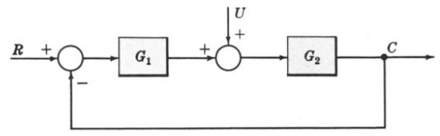

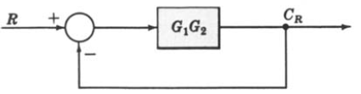
Example-18: Multiple Input System. Determine the output C due to inputs R and U using the Superposition Method.

Slide 55
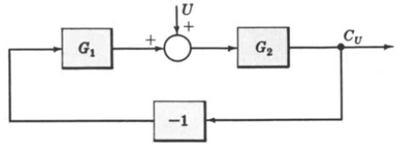
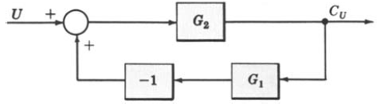
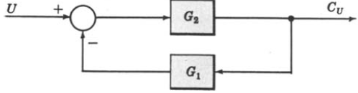
Example-18: Continue.

Slide 56


Example-18: Continue.

Slide 57
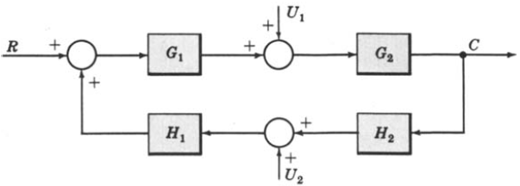
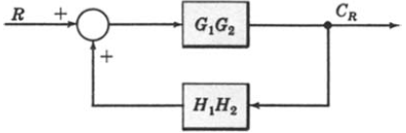
Example-19: Multiple-Input System. Determine the output C due to inputs R, U1 and U2 using the Superposition Method.

Slide 58
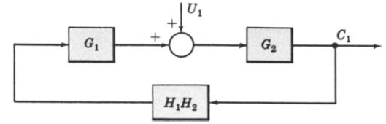
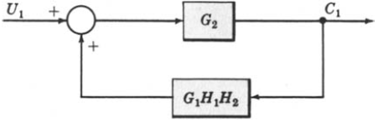
Example-19: Continue.

Slide 59
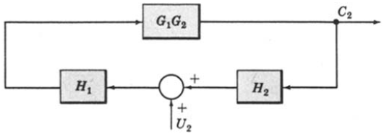
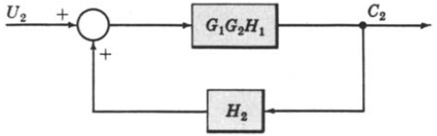

Example-19: Continue.

Slide 60
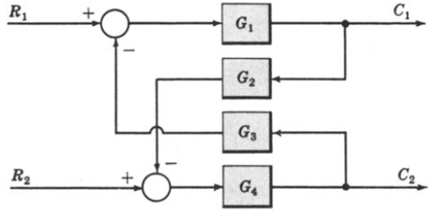
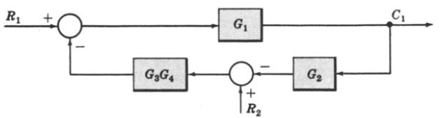
Example-20: Multi-Input Multi-Output System. Determine C1 and C2 due to R1 and R2.

Slide 61
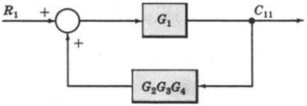
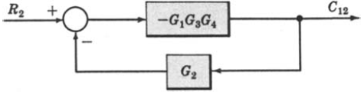
Example-20: Continue.

Slide 62
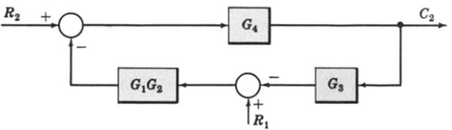
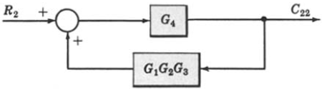
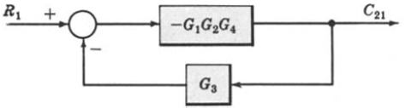
Example-20: Continue.
When R1 = 0,
When R2 = 0,

Slide 63
Block Diagram of Armature Controlled D.C Motor
R_{a}
L_{a}
c
i_{a}
V_{a}
e_{b}
T
J
ω
V_{f}=constant

Slide 64
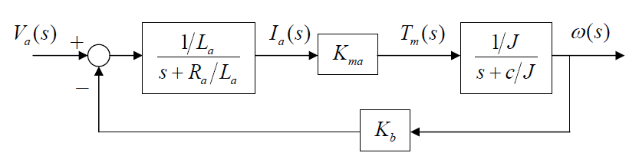
Block Diagram of Armature Controlled D.C Motor

Slide 65


Block Diagram of Armature Controlled D.C Motor

Slide 66

Block Diagram of Armature Controlled D.C Motor

Slide 67

Block Diagram of liquid level system

Slide 68
Block Diagram of liquid level system
L
L
L
L

Slide 69




Block Diagram of liquid level system

Slide 70

Block Diagram of liquid level system

Slide 71
End of Lectures-14-15
To download this lecture visit
http://imtiazhussainkalwar.weebly.com/

